Slide 1

Memory Composition (C++)
Custom Types
Objects on the Stack
Object Slicing
References and Pointers

Slide 2

See Also
https://en.wikipedia.org/wiki/Object_slicing
https://www.geeksforgeeks.org/pointers-vs-references-cpp/
Notes:
Here is some additional reading for you on the web.

Slide 3
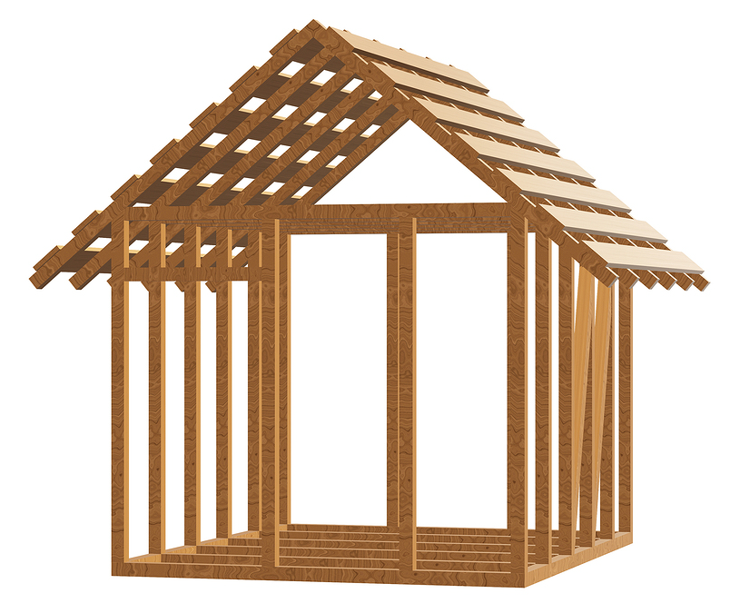
Custom Types
Make your own built-in-like types
Operator overloading for things like: +, =, *, ., [ ]
Memory copy just like true built-ins
Copy-constructors and equals operators
Be careful with polymorphism (object slicing)
C++
int a, b;
b = a;
a = a + b;
Point x, y;
y = x;
x = x + y;
Point g = doStuff(a, x);

Slide 4
Objects on the Stack
class Point {
public:
int x, y, z;
};
Stack
C++
x
5
Point pointDouble(Point p) {
int b = p.x * 2;
}
int main(int argc, char ** argv) {
int x = 5;
Point a; // Not "Point a();"
Point b;
a.x = 10;
a.y = 20;
b = pointDouble(a);
}
C++
a
x
10
y
20
z
b
x
y
z
return
p
x
10
y
20
z
b
20

Slide 5
Objects on the Stack
class Point {
public:
int x, y, z;
};
Stack
C++
x
5
Point pointDouble(Point p) {
int b = p.x * 2;
p.x = b;
Point w;
w.x = 2;
w.y = 3;
p = w;
return w;
}
int main(int argc, char ** argv) {
int x = 5;
Point a; // Not "Point a();"
Point b;
a.x = 10;
a.y = 20;
b = pointDouble(a);
}
C++
a
x
10
y
20
z
b
x
2
y
3
z
return
p
x
10
2
20
20
y
3
z
b
20
w
x
2
y
3
z

Slide 6


Objects on the Stack
class Point {
public:
int x, y, z;
};
Stack
C++
x
5
Point pointDouble(Point p) {
int b = p.x * 2;
p.x = b;
Point w;
w.x = 2;
w.y = 3;
p = w;
return w;
}
int main(int argc, char ** argv) {
int x = 5;
Point a; // Not "Point a();"
Point b;
a.x = 10;
a.y = 20;
b = pointDouble(a);
cout << a.x << endl;
cout << b.x << endl;
}
C++
a
x
10
y
20
z
b
x
2
y
3
z
10
2

Slide 7
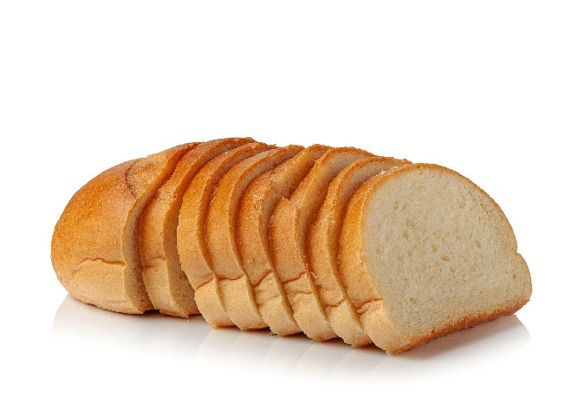
Object Slicing
class Point {
public:
int x, y;
virtual void speak() {
cout << "In Point" << endl;
}
};
class LoudPoint: public Point {
public:
int volume;
virtual void speak() {
cout << "In LoudPoint" << endl;
}
};
class HoldLoudPoint: public LoudPoint {
public:
int hold;
virtual void speak() {
cout << "In HoldLoudPoint" << endl;
}
};
C++
void pointSpeak(Point p) {
p.speak();
}
int main(int argc, char ** argv) {
HoldLoudPoint h;
pointSpeak(h);
}
C++
In Point
Notes:
Subclasses have different sizes

Slide 8
Object Slicing
class Point {
public:
int x, y;
virtual void speak() {
cout << "In Point" << endl;
}
};
class LoudPoint: public Point {
public:
int volume;
virtual void speak() {
cout << "In LoudPoint" << endl;
}
};
class HoldLoudPoint: public LoudPoint {
public:
int hold;
virtual void speak() {
cout << "In HoldLoudPoint" << endl;
}
};
void pointSpeak(Point p) {
p.speak();
}
int main(int argc, char ** argv) {
HoldLoudPoint h;
pointSpeak(h);
}
C++
Stack
h
vtab
HoldLoudPoint
x
y
volume
hold
return
p
vtab
Point
x
y
In Point

Slide 9
Object Slicing
class Point {
public:
int x, y;
virtual void speak() {
cout << "In Point" << endl;
}
};
class LoudPoint: public Point {
public:
int volume;
virtual void speak() {
cout << "In LoudPoint" << endl;
}
};
class HoldLoudPoint: public LoudPoint {
public:
int hold;
virtual void speak() {
cout << "In HoldLoudPoint" << endl;
}
};
void pointSpeak(Point * p) {
p->speak();
}
int main(int argc, char ** argv) {
HoldLoudPoint h;
pointSpeak(&h);
}
C++
Stack
h
vtab
HoldLoudPoint
x
y
volume
hold
return
p
0390
In HoldLoudPoint

Slide 10
C++ References
class Point {
public:
int x, y;
virtual void speak() {
cout << "In Point" << endl;
}
};
class LoudPoint: public Point {
public:
int volume;
virtual void speak() {
cout << "In LoudPoint" << endl;
}
};
class HoldLoudPoint: public LoudPoint {
public:
int hold;
virtual void speak() {
cout << "In HoldLoudPoint" << endl;
}
};
void pointSpeak(Point & p) {
p.speak();
p.x = 123;
}
int main(int argc, char ** argv) {
HoldLoudPoint h;
pointSpeak(h);
}
C++
Stack
h
vtab
HoldLoudPoint
x
y
volume
hold
return
p
0390
In HoldLoudPoint
Surprise?
Produces the same code
Syntactically easier
Still must manage shared references

Slide 11
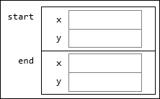
Memory Composition
class Line {
public:
Point start;
Point end;
};
class Chart {
public:
Line axis1;
Line axis2;
Line axis3;
};
Line a;
Chart b;
Chart * c = new Chart();
a.start.x = 20;
C++
Stack
Heap
a
start
x
Chart
0500
y
axis1
end
x
y
axis2
b
axis1
axis3
axis2
axis3
c
0500

Slide 12
Memory Composition
class Line {
public:
Point * start;
Point * end;
};
Point * common = new Point();
Line a;
Line b;
a.start = common;
b.start = common;
a.start->x = 20;
cout << b.start->x;
C++
Stack
Heap
common
0700
Point
0700
a
start
0700
x
20
end
y
b
start
0700
end
20

Slide 13

Tinkering
Type in the Point/Line code.
Make a ColorPoint that extends Point.
Add getters for X and Y in the Point class, and put a print statement to say “I am here”.
Override the getter in ColorPoint to print something else.
Make a function that takes a Point and calls getX.
Demonstrate object slicing by passing in a ColorPoint.
Experiment with pointers and references to preserve the polymorphism.
Notes:
Here are a couple of things to think about and/or try. This is totally optional … nothing for you to send to me.

